Slide 1
ERYTHROPOIESIS
BASIC HAEMATOLOGY (MLS 332)

Slide 2
Outline
Blood cell development
Haemopoietic growth factors
Functions of blood
Stages of red cell development

Slide 3
Blood Cell Development
The pluripotent stem cell is the first in a sequence of steps of hematopoietic cell generation and maturation.
The progenitor of all blood cells is called the pluripotential hematopoietic stem cell.
These cells have the capacity for self-renewal as well as proliferation and differentiation into progenitor cells committed to one specific cell line.
The pluripotential stem cell is the progenitor for two major ancestral cell lines: Lymphocytic and non-lymphocytic cells.

Slide 4
Blood Cell Development
The lymphoid stem cell is the precursor of mature T cells or B cells/ plasma cells.
The non-lymphocytic (myeloid) stem cell is progenitor to CFU-GEMM (colony-forming unit granulocyte-erythrocyte-monocyte-megakaryocyte).
The CFU_{GEMM} can lead to the formation of BFU_{E} (burst-forming unit erythrocyte), CFU_{GM} (CFU-granulocyte-macrophage / monocyte), CFU_{Eo} (CF-Eosinophil), CFU_{Ba} (CFU-basophil) And CFU_{Meg} (CFU-Megakaryocyte).

Slide 5
Blood Cell Development
In erythropoiesis, the CFU-GEMM differentiates, into the BFU-E (Burst-Forming unit Erythroid).
Each of the CFUs in turn can produce a colony of one haematopoietic lineage under appropriate growth conditions.
CFU-E is the target cells for erythropoietin.

Slide 6
Haematopoietic Growth Factors (HGFs)
The haematopoietic growth factors are glycoprotein hormones that regulate the proliferation and differentiation of hematopoietic progenitor cells and the function of mature blood cells.
These growth factors were referred to as colony stimulating factors (CSFs) because they stimulated the formation of colonies of cells derived from individual bone marrow progenitors.

Slide 7
Haematopoietic Growth Factors (HGFs)
Erythropoietin, granulocyte-macrophage colony stimulating factors (GM-CSF) granulocyte colony stimulating factor (G-CSF), macrophage colony stimulating factor (M-CSF) and interleukin-3 are representative factors that have been identified, cloned and produced through recombinant DNA technology.
The haematopoietic growth factors interact with blood cells at different levels in the cascade of cell differentiation from the pluripotential progenitor to the circulating mature cell.

Slide 8
Growth Factor | Source | Major function
GM-CSF | T-Lymphocyte, endothelial cells, Fibroblasts | Stimulates production of neutrophils, eosinophils, monocytes, red cells and platelets.
G-CSF | Monocytes, Fibroblasts | Stimulates production of neutrophils
M-CSF | Macrophages, Endothelial cells | Stimulates production of monocytes
Erythropoietin | Peritubular cells, liver, macrophages | Stimulates production of red cells
Interleukin-1 | Macrophages, Activated lymphocytes, Endothelial cells | Cofactor for IL-3, IL-6. activated T cells
Interleukin-2 | Activated T cells | T cell growth factor. Stimulates IL-1 synthesis. Activated B cells and NK cells
Interleukin-3 | T Cells | Stimulates production of all non-lymphoid cells
Interleukin-4 | Activated T Cells | Growth factor for activated B cells, resting T cells and mast cells
Interleukin-5 | T Cells | Induces differentiation of activated B cells and eosinophils.
Interleukin-6 | T Cells | Stimulates CFU-GEMM Stimulates Ig synthesis
Interleukin-7 | T cells, Fibroblasts, Endothelial cells | Growth factor for pre B cells

Slide 9
Composition of Blood
- Blood is the body’s only fluid tissue
- It is composed of liquid plasma and formed elements
Formed elements include:
Erythrocytes, or red blood cells (RBCs)
Leukocytes, or white blood cells (WBCs)
Platelets
Haematocrit – the percentage of RBCs out of the total blood volume (e.g. 43 ml of 100 ml total blood = 43%)

Slide 10
Physical Characteristics and Volume
Blood is a sticky, opaque fluid with a metallic taste
Colour varies from scarlet (oxygen-rich) to dark red (oxygen-poor)
The pH of blood is 7.35–7.45
Temperature is 38°C, slightly higher than “normal” body temperature
Blood accounts for approximately 8% of body weight
Average volume of blood is 5–6 L for males, and 4–5 L for females

Slide 11
Functions of Blood
Blood performs a number of functions dealing with:
Substance distribution
Regulation of blood levels of particular substances
Body protection

Slide 12
Distribution
Blood transports:
Oxygen from the lungs and nutrients from the digestive tract
Metabolic wastes from cells to the lungs and kidneys for elimination
Hormones from endocrine glands to target organs

Slide 13
Regulation
Blood maintains:
Appropriate body temperature by absorbing and distributing heat
Normal pH in body tissues using buffer systems
Adequate fluid volume in the circulatory system

Slide 14
Protection
Blood prevents blood loss by:
Activating plasma proteins and platelets
Initiating clot formation when a vessel is broken
Blood prevents infection by:
Synthesizing and utilizing antibodies
Activating complement proteins
Activating WBCs to defend the body against foreign invaders

Slide 15
Blood Plasma
Blood plasma contains over 100 solutes:
Proteins – albumin, globulins, clotting proteins, and others
Nonprotein nitrogenous waste substances – lactic acid, urea, creatinine
Organic nutrients – glucose, carbohydrates, amino acids
Electrolytes – sodium, potassium, calcium, chloride, bicarbonate
Respiratory gases – oxygen and carbon dioxide

Slide 16
Formed Elements
Erythrocytes, leukocytes, and platelets make up the formed elements
Only WBCs are complete cells
RBCs have no nuclei or organelles, and platelets are just cell fragments
Most formed elements survive in the bloodstream for only a few days
Most blood cells do not divide but are renewed by cells in bone marrow

Slide 17
Erythrocytes (RBCs)
Biconcave discs, anucleate, essentially no organelles
Filled with hemoglobin (Hb), a protein that functions in gas transport
Contain the plasma membrane protein spectrin and other proteins that:
Give erythrocytes their flexibility
Allow them to change shape as necessary

Slide 18
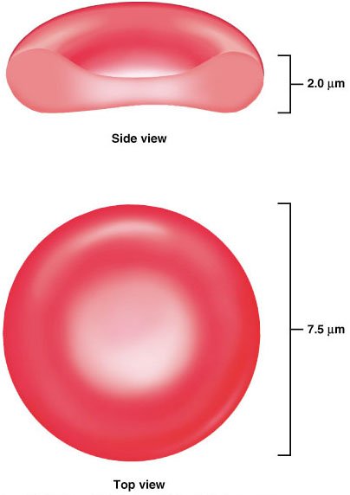
Erythrocytes (RBCs)
Figure 17.3

Slide 19
Erythrocytes (RBCs)
Erythrocytes are an example of the complementarity of structure and function
Structural characteristics contribute to its gas transport function:
Biconcave shape that has a huge surface area relative to volume
Discounting water content, erythrocytes are more than 97% hemoglobin
ATP is generated anaerobically, so the erythrocytes do not consume the oxygen they transport

Slide 20
Erythrocyte Function
Erythrocytes are dedicated to respiratory gas transport
Haemoglobin reversibly binds with oxygen and most oxygen in the blood is bound to hemoglobin
Haemoglobin is composed of the protein globin, made up of two alpha and two beta chains, each bound to a heme group
Each haem group bears an atom of iron, which can bind to one oxygen molecule
Each hemoglobin molecule can transport four molecules of oxygen

Slide 21
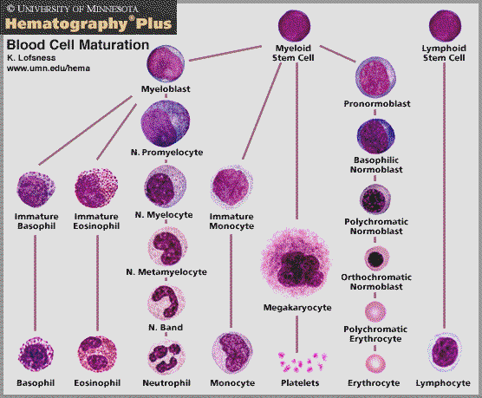

Slide 22
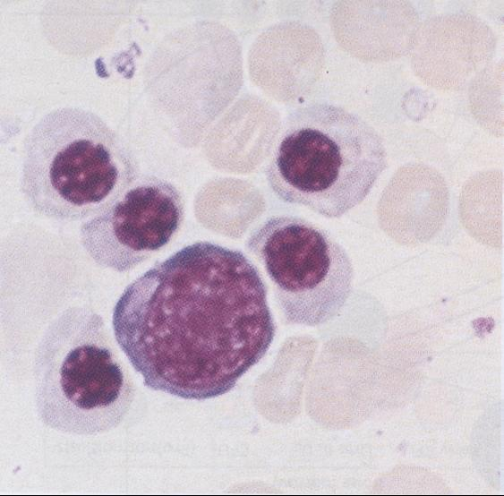
Erythropoiesis and erythrocytes
Lifespan – 120 days
Non nucleated
Biconcave disc
Production regulated by Epo
Needs Fe, B12, folate & other elements for development

Slide 23
ERYTHROPOIESIS
In developing from the stem cell, the RBC has to undergo the most changes, which can be categorized into several morphological/stainable stages and into less easily detected early stages *
*
stem
cell
RBC
NORMOBLAST
basophilic
polychromatophilic
ERYTHROBLAST
orthochromatophilic
-blast is the common suffix for an immature form of a cell

Slide 24
ERYTHROPOIESIS
stem
cell
RBC
NORMOBLAST
basophilic
polychromatophilic
ERYTHROBLAST
orthochromatophilic
polychromatophilic because, in the cell, orange-staining hemoglobin is accumulating, while the blue ribosomes necessary for its synthesis are present, but declining
This idea continues in the form of the reticulocyte which is an RBC released to the blood, but still with a network of blue ribosomal material persisting amongst the hemoglobin

Slide 25
Stages of red cell development
Pronormoblast: Size 12- 19 um in diameter N:C ratio 4:1 Nucleus Large, round nucleus Chromatin has a fine pattern 0-2 nucleoli’ Cytoplasm: distinctive basophilic colour without granules
Basophilic Normoblast : Size 12- 17 um in diameter N:C ratio 4: 1 Nucleus: Nuclear chromatin more clumped Nucleoli usually not apparent Cytoplasm: Distinctive basophilic colour

Slide 26
Stages of red cell development
Polychromatic Normoblast: Size 11-15 um in diameter N:C ratio 1:1 Nucleus: Increased clumping of the chromatin Cytoplasm: Colour: Variable, with pink staining Mixed with Basophilia
Orthochromic Normoblast: or nucleated RBC Size: 8-12 um Nucleus: Chromatin pattern is tightly condensed. Cytoplasm: Colour: reddish-pink (acidophilic)

Slide 27
Stages of red cell development
Reticulocyte (Supravital stain): Size 7-10 um Cell is a nuclear Polychromatic Erythrocyte Diffuse reticulum (Wright stain) Cytoplasm: Overall blue appearance
Erythrocyte: Average diameter 6-8 um

Slide 28
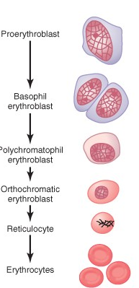

Slide 29

Proerythroblast
No haemoglobin
Nucleus 12 um
Contain nucleoli

Slide 30

Basophil erythroblast
Early normoblast
Nucleoli disappear
Show mitosis
Cytoplasm deep blue
Increase in RNA
Haemoglobin starts appearing – Little Hb

Slide 31

Polychromatophil erythroblast
Late normoblast
Nucleus smaller
Coarse Chromatin
Haemoglobin increase
Eosinophil Stain
RNA – Basophil stain

Slide 32

Orthochromatic Erythroblast
Normoblast
Nucleus smaller
Pyknosis
Nuclear lysis and
Nuclear extrusion

Slide 33

Reticulocyte
Reticulum
Remnant of ER & GA
Synthesize Hb
Few Mitochondria
Young RBCs (34% Hb)
1 % of Red Cells

Slide 34
Transfer of RBC to Circulation
RBC pass from the bone marrow into the blood capillaries
By
Diapedesis
(squeezing through the pores of the capillary membrane).

Slide 35
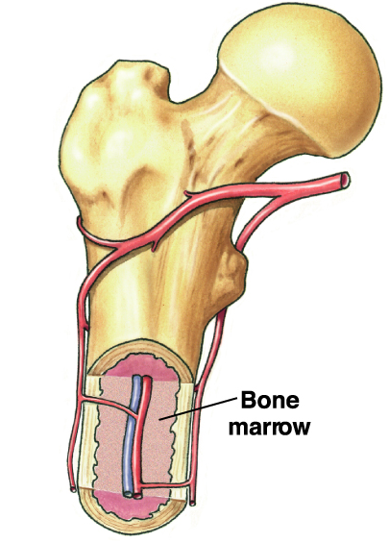
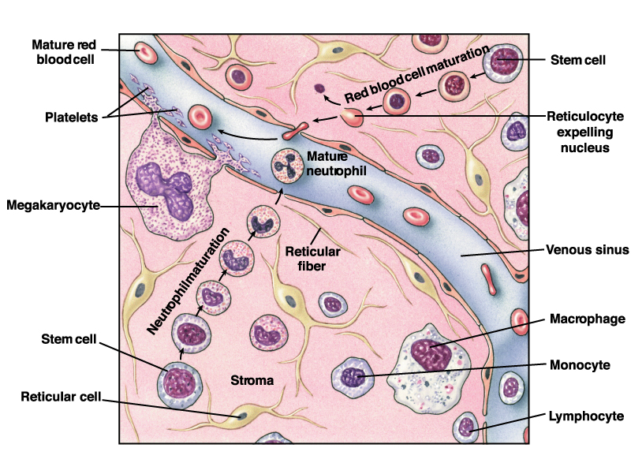

Slide 36
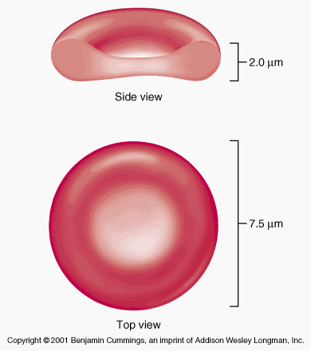
Erythrocytes
Round, biconcave, disc shaped.
Smooth contours
Diameter 7.8 um.
Normally no variation in size and shape.
Stain with EOSIN.
More stain at periphery
Can deform easily.

Slide 37
